Slide 1

AIRBNB ANALYTICS CASE STUDY BY SURABHI GOYAL

Slide 2
Agenda
Introduction
Overview
Objectives
Dataset Details
Data Analysis In MySQL
Business Insights

Slide 3
INTRODUCING SURABHI GOYAL
Result-oriented Data Analyst with a proven ability to extract meaningful insights from complex data. Skilled in SQL, Python, and data visualization tools, I leverage statistical analysis and data mining techniques to drive business decisions.

Slide 4
OVERVIEW
The project involves leveraging extensive databases within a dynamic e-commerce company to extract actionable insights. The objective is to inform key departments-such as marketing and supply chain-on strategic decisions that optimize operations, improve customer satisfaction, and enhance sales performance. This initiative aims to utilize data analysis to drive forward the company's business strategies effectively.

Slide 5
OBJECTIVES
User Behavior and Engagement: Identify key user segments based on demographics, behavior, and preferences.
Geographic Insights: Analyze geographic distribution of users to identify key markets.
Sales Optimization: Analyzing sales data to identify trends, opportunities, and areas for improvement.
Platform Performance: Track key performance indicators (KPIs) such as booking rates, conversion rates, and revenue.

Slide 6
DATASET DETAILS
Users Table: This table contains comprehensive user data for a travel or booking platform, encompassing personal details, account information, marketing interactions, device usage, and travel preferences.
Sessions Table: Analyze geographic distribution of users to identify key markets.
Countries Table: This table provides insights into destination countries, including their geographical locations, distances from users, area sizes, primary languages spoken, and a measure of language similarity.

Slide 7

DATA ANALYSIS IN MYSQL

Slide 8


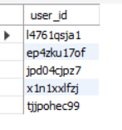
Engaging the audience
Problem Statement:
Identify the top 5 most active users who have spent more than 10,000 seconds on at least one session.
'Most active' is defined as having the highest number of sessions.
This will help you analyze user session data to find a potential correlation between session duration and user activity.
Make eye contact with your audience to create a sense of intimacy and involvement
Weave relatable stories into your presentation using narratives that make your message memorable and impactful
Encourage questions and provide thoughtful responses to enhance audience participation
Use live polls or surveys to gather audience opinions, promoting engagement and making sure the audience feel involved

Slide 9
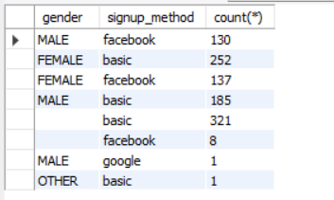
Engaging the audience
Problem Statement:
determine the most frequently used signup method for each Gender category, considering only users who have made a booking (as indicated by a non-null value in the Date_first_booking column).
This exploration will help us understand if certain demographic factors are associated with specific signup preferences among users who follow through
with bookings.
Make eye contact with your audience to create a sense of intimacy and involvement
Weave relatable stories into your presentation using narratives that make your message memorable and impactful
Encourage questions and provide thoughtful responses to enhance audience participation
Use live polls or surveys to gather audience opinions, promoting engagement and making sure the audience feel involved

Slide 10

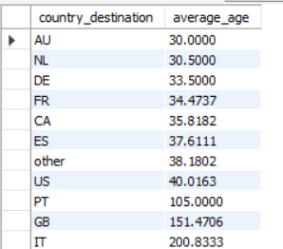
Engaging the audience
Problem Statement:
Determine the average age of users by destination country, considering only those with a booking and available age data.
Sort the results from the youngest to the oldest users.
This will help you understand the destination country preferences for different age of users.
Make eye contact with your audience to create a sense of intimacy and involvement
Weave relatable stories into your presentation using narratives that make your message memorable and impactful
Encourage questions and provide thoughtful responses to enhance audience participation
Use live polls or surveys to gather audience opinions, promoting engagement and making sure the audience feel involved

Slide 11
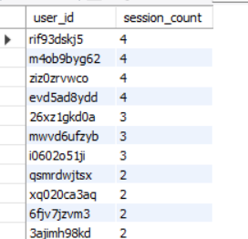
Engaging the audience
Problem Statement:
Write a query to find users with fewer than 5 sessions who made a booking to the destination "US".
Sort the results by the number of sessions in descending order.
Make eye contact with your audience to create a sense of intimacy and involvement
Weave relatable stories into your presentation using narratives that make your message memorable and impactful
Encourage questions and provide thoughtful responses to enhance audience participation
Use live polls or surveys to gather audience opinions, promoting engagement and making sure the audience feel involved

Slide 12

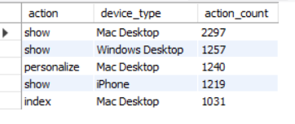
Engaging the audience
Problem Statement:
Write a SQL query to identify the top 5 most common actions performed by users who made a booking (i.e., country_destination is not 'NDF') and the devices they use for these actions.
This information can help in optimizing the user experience and tailoring the interface to common user behaviors.
Make eye contact with your audience to create a sense of intimacy and involvement
Weave relatable stories into your presentation using narratives that make your message memorable and impactful
Encourage questions and provide thoughtful responses to enhance audience participation
Use live polls or surveys to gather audience opinions, promoting engagement and making sure the audience feel involved

Slide 13
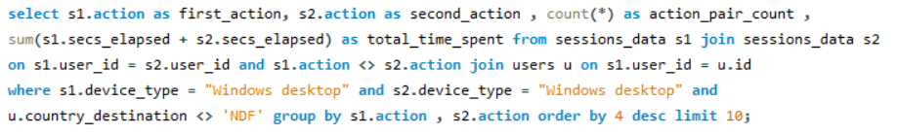
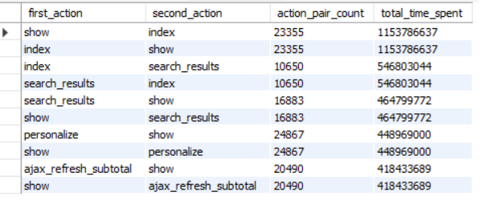
Engaging the audience
Problem Statement:
Write a SQL query to find the most frequent combinations of two actions (performed by the same user on Windows Desktop devices) where the most time is spent,
for users who have made a booking (i.e., country_destination is not 'NDF').
Consider the top 10 combinations from the resulting table which will be considered as most frequent.
Make eye contact with your audience to create a sense of intimacy and involvement
Weave relatable stories into your presentation using narratives that make your message memorable and impactful
Encourage questions and provide thoughtful responses to enhance audience participation
Use live polls or surveys to gather audience opinions, promoting engagement and making sure the audience feel involved

Slide 14
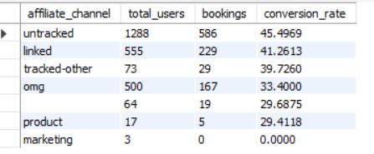
Engaging the audience
Problem Statement:
To understand which affiliate channels are most effective, analyze the number of bookings made through each first affiliate channel and calculate
their conversion rates.
Write an SQL query to find the number of bookings and the conversion rate for each first affiliate channel. Consider a booking as made if country_destination is not 'NDF'.
Make eye contact with your audience to create a sense of intimacy and involvement
Weave relatable stories into your presentation using narratives that make your message memorable and impactful
Encourage questions and provide thoughtful responses to enhance audience participation
Use live polls or surveys to gather audience opinions, promoting engagement and making sure the audience feel involved

Slide 15

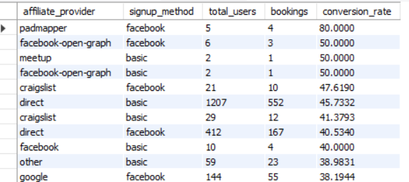
Engaging the audience
Problem Statement:
To further understand the effectiveness of different affiliate providers and signup methods, determine the conversion rate for each combination.
Write a SQL query to calculate the conversion rate for each combination of affiliate provider and signup method. Consider a booking as made
if country_destination is not 'NDF'.
Make eye contact with your audience to create a sense of intimacy and involvement
Weave relatable stories into your presentation using narratives that make your message memorable and impactful
Encourage questions and provide thoughtful responses to enhance audience participation
Use live polls or surveys to gather audience opinions, promoting engagement and making sure the audience feel involved

Slide 16
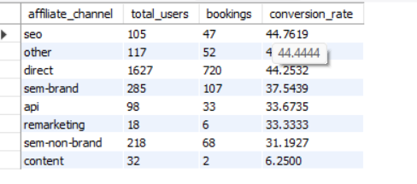
Engaging the audience
Problem Statement:
Write a SQL query to assess the effectiveness of different marketing channels by calculating the conversion rate for each affiliate channel.
Consider a booking as made if country_destination is not 'NDF'.
Make eye contact with your audience to create a sense of intimacy and involvement
Weave relatable stories into your presentation using narratives that make your message memorable and impactful
Encourage questions and provide thoughtful responses to enhance audience participation
Use live polls or surveys to gather audience opinions, promoting engagement and making sure the audience feel involved

Slide 17

BUSINESS INSIGHTS
'US’ and 'France' are those destinations where mostly users visited so these countries to be focused on as part of the marketing strategies.
'iPhones' are the most common device for users overall, but for users who spend the most time on the platform, 'Mac desktops' dominate. This suggests 'Mac' users might be more engaged in the planning and browsing process.
Analyzing sessions by user helps identify "power users" with high session counts and long session durations. Exploring their behavior can provide valuable insights into user journeys and areas for improvement.
Most frequent signup method for female users with bookings is 'Basic' and for male users, it is 'Facebook' which can be a good target for marketing efforts.
Age group of '30-40' prefers their destination countries are ‘Australia’, 'Netherlands', 'Germany' and '40-more' prefers 'US', 'Portugal’.
Total clicks made by organic users are '8469' which helps to assess its overall activity and potential impact.

Slide 18
'Show' and 'Index' are the actions type in which most time was taken by the user sequentially which help optimize the user journey by focusing on significant action pairs on Windows Desktop.
'Untracked' and 'Linked' are the most affiliate channels for user acquisition (conversion rate is the highest) which helps us to inform marketing budget allocation and partnerships.
Combination of affiliate provider and signup method is ‘Pad-mapper' and 'Facebook' which gives the highest conversion rate and hence it is the best to tailor user acquisition strategies for specific demographics and marketing channels.

Slide 19
Recommendations based on the insights:
Cater the interface to browsing and planning activities, potentially on larger screens.
Analyze and understand power user behavior to identify potential pain points and areas for improvement.
Use location and user demographics to tailor marketing campaigns for specific regions and user groups.
Promote the most effective signup methods for different user segments based on demographics or referral sources.
Implement strategies to encourage organic user engagement and conversion.
Analyze actions with low average time spent and consider content or interface improvements.
Allocate marketing budget and resources to affiliate channels with the highest conversion rates.
Test different signup methods for each affiliate provider to optimize conversion rates.

Slide 20

THANK YOU!
+91-8958936840
surabhigoyal198@gmail.com
https://github.com/SurabhiGoyal-Coder
https://www.linkedin.com/in/surabhi-goyal-36154a207

